Slide 1


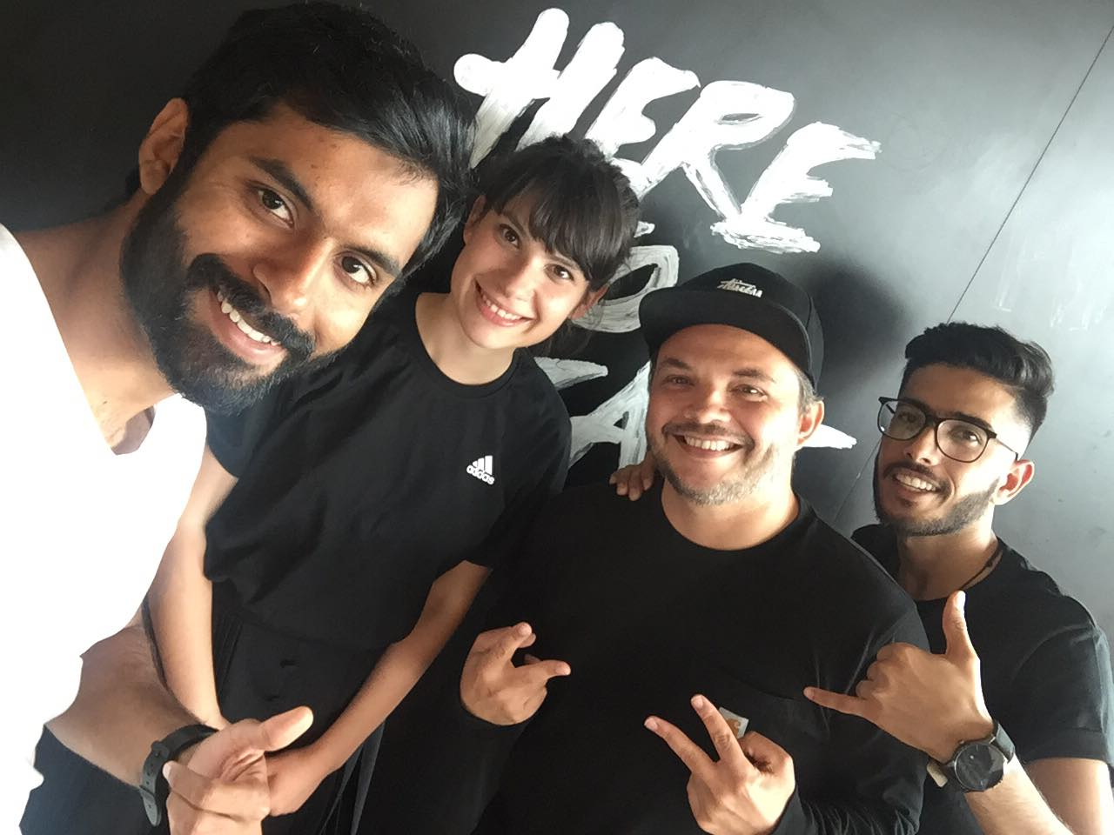


<TEAM FLOW>
TEAM PICTURE
Lavinia Vaduva
Glazione Rocha
Ramin Ghaderi
Nashib Ul Khamash
<Personalize the next gen shopping experience>
<Personal Virtual Shopping Assistant >
Image Processing
Augmented Reality
TECHNOLOGIES
Artificial Intelligence
IoT

